Slide 1
SORTING ALGORITHM VISUALISER
Submitted by- GOURAV ROY
College- LNCT BHOPAL
Enrollment no.-0103EX201029
EX, 7th sem

Slide 2
Introduction
This is an interactive project that helps us to understand the working of various sorting algorithms by visualizing the sorting process step by step.
These visualiser allows users to see how elements are rearranged and sorted in real-time, providing a visual representation of the algorithm’s behavior.

Slide 3
PROJECT OVERVIEW
This project consists of the following parts:-
New Array- This is used to select a new array or reset the existing one.
Size- This is used to vary size array.
Speed-This is used to vary the speed of visualization of sorting.
Algorithm selector-This is used to select among the various arrays.
Array bars- This displays the array elements in the form of bars.

Slide 4
SORTING ALGORITHMS
Various Sorting algorithms can be visualized:-
Bubble Sort
Selection Sort
Insertion Sort
Merge Sort
Quick Sort

Slide 5
Bubble sort
Comparing adjacent elements
Swapping elements if they are in the wrong order.
Iterating through the array multiple time until the array is sorted.

Slide 6
Selection sort
Dividing the array into sorted and unsorted parts.
Finding the smallest(or largest) element in the unsorted and swapping it with the first unsorted element.
Growing the sorted part of the array after each iteration.

Slide 7
Insertion sort
Building the final sorted array one item at a time.
Comparing the first unsorted element with the elements in the sorted part and inserting it in the correct position.
Growing the sorted part of the array after each iteration.

Slide 8
Merge sort
Divide the array into smaller subarrays until each subarray contains only one element.
Merge the sorted subarrays to create larger and larger sorted subarrays.
Continue merging until the entire array is sorted.

Slide 9
Quick sort
Select a pivot element and partition that array around the pivot.
Recursively apply the same process to the subarrays until each subarray is sorted.
Combine the sorted subarrays to obtain the final sorted array.

Slide 10
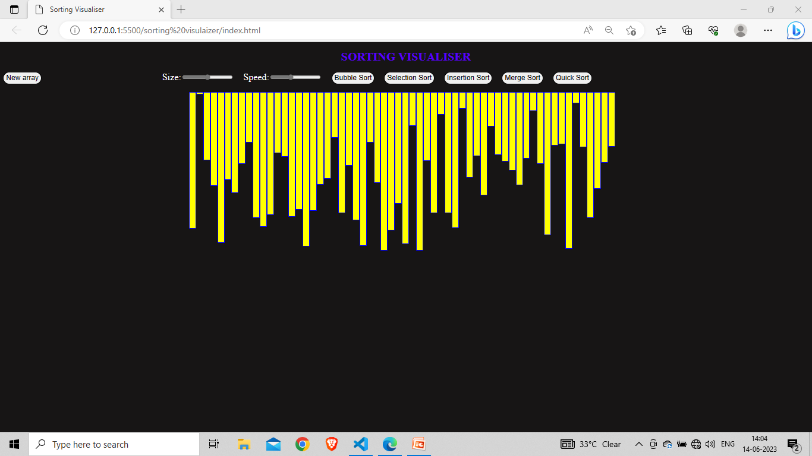
Array to be sorted

Slide 11
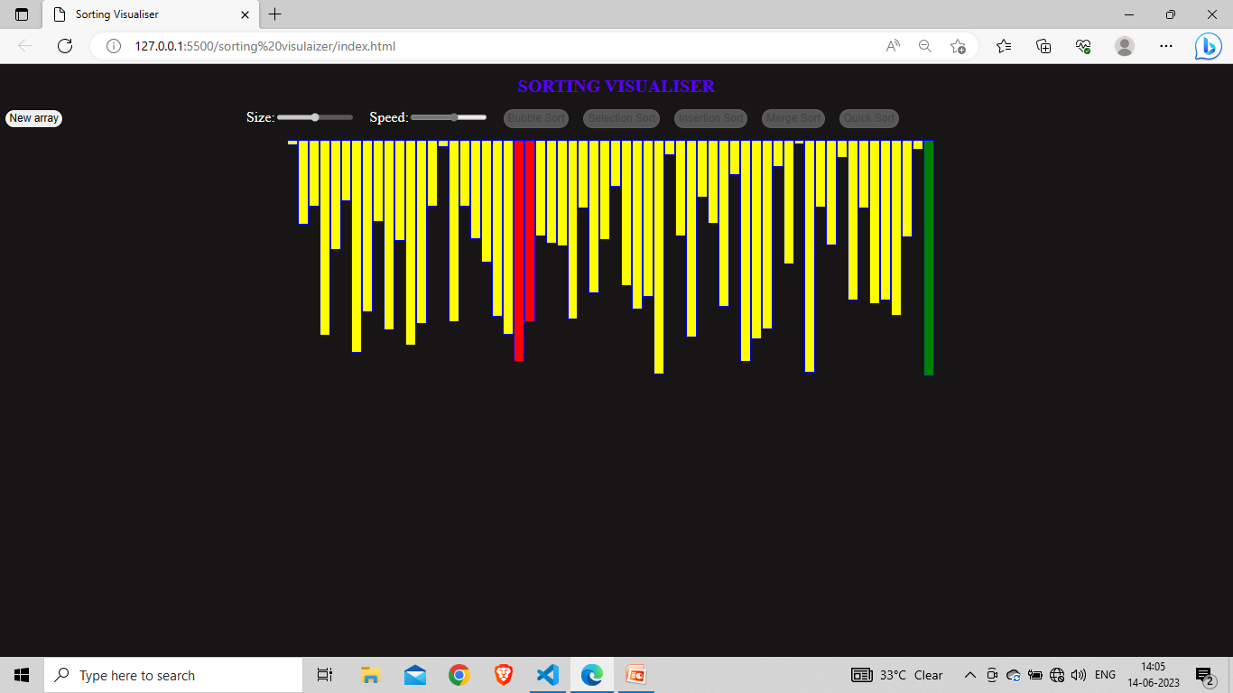
GREEN SHOWS SORTED ELEMENT RED SHOWS THE ELEMENT UNDERGOING SORTING

Slide 12
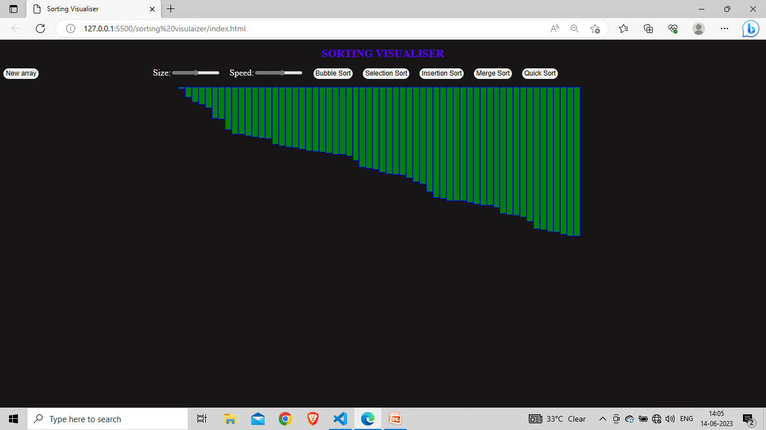
SORTED ARRAY

